Slide 1
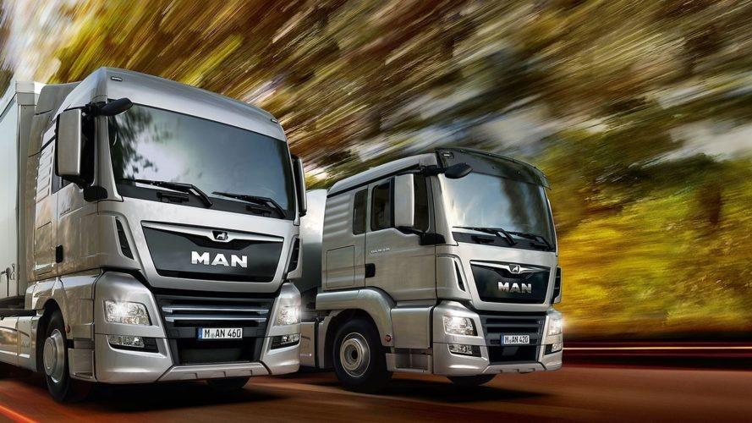

</ MAN DigitalServices Predictive Tire Breakdown>
</ CODING THE NEW>
MAN Hackathon - 12/2019

Slide 2
MAN needs to tackle the “real” & most severe problems of their customers and deeply understand their changing needs and technology desires.

Slide 3

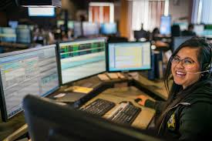
MAN’s most crucial customers are
fleet managers and their dispatchers
Fleet Manager:
Responsible for the entire fleet operation and its cost-effectiveness
Decision-maker on buying trucks and other related digital services
Dispatcher:
Plan the trucks’ routes and their delivery fulfillment to reach full utility and have all trucks on the road
Key user of MAN’s related digital service offerings

Slide 4
Challenges for this customer group:
Downtime due truck failures
Top 3 drivers of truck failures
Tire blasts
#1
Additional maintenance activities on defect trucks reduce fleet uptime while increasing extra repair costs and delays on customer orders.
Brake abrasion
#2
Fuel tank issues
#3

Slide 5
Our Solution:
MAN Predictive Tire Breakdown
Digital service offering that enables real-time notifications of tire breakdown predictions while providing suitable actions for countermeasures including informing relevant affected stakeholders.

Slide 6

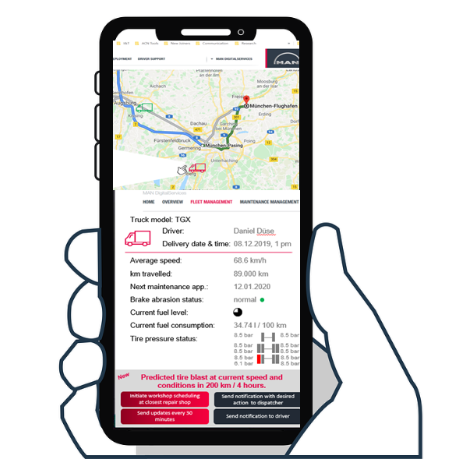
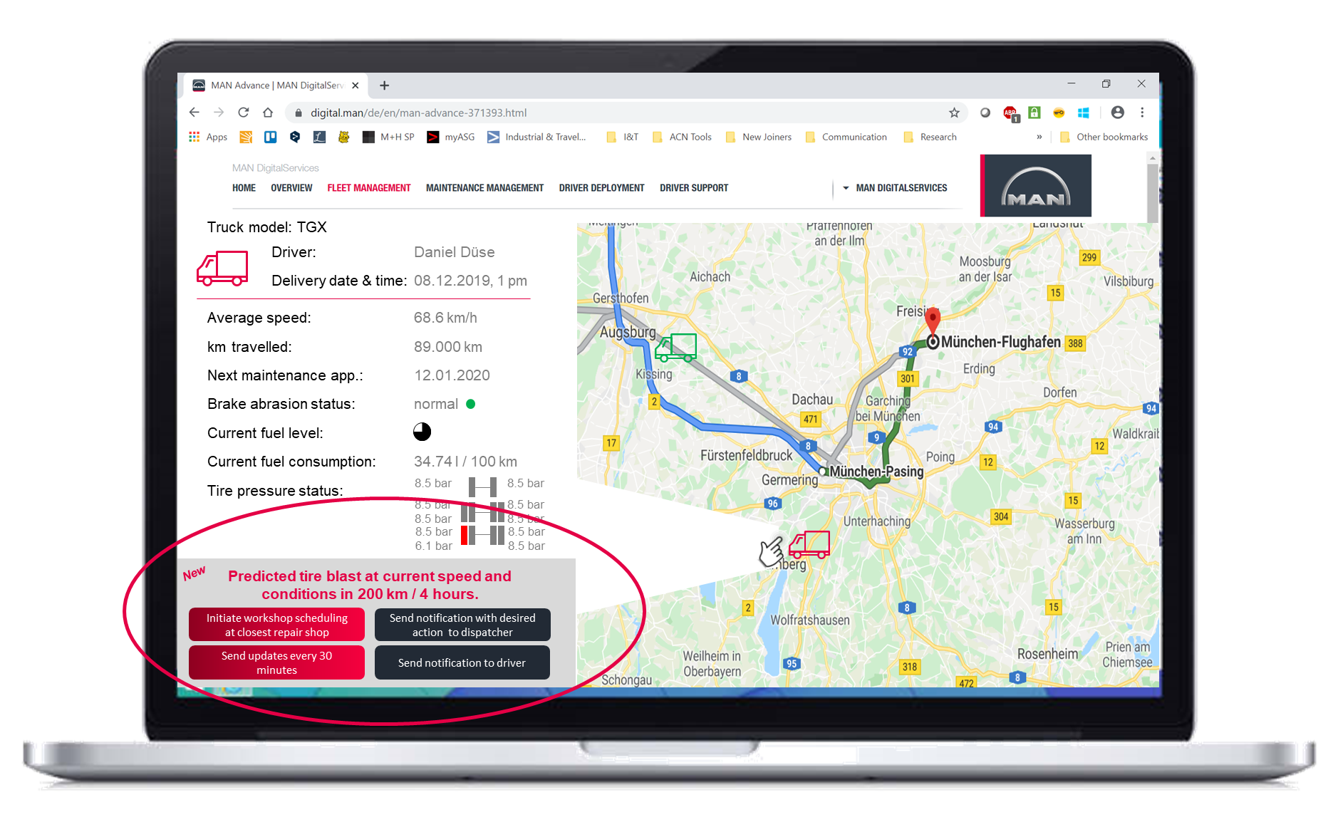
Customer Journey
1
Get inspired @MAN Predictive Tire Breakdown
3
Usage: Predict status & receive alert
Via App, portal
2
Purchase & activate service
4
Trigger action
Notification to dispatcher
5
Initiate action
Information to driver & workshop
Repair
6
Prevent breakdown: Workshop visit
8
Develop further services & upgrades
Smarter predictive models

Slide 7
Customer’s Benefits
1
Reduction in tire pressure & condition-related truck failures, increased uptime
2
Real-time status tracking and enhanced transparency for all involved stakeholders
3
Failure predictions with interlinked suggestions for next best actions and initial trigger of action
4
Easy-to-use

Slide 8
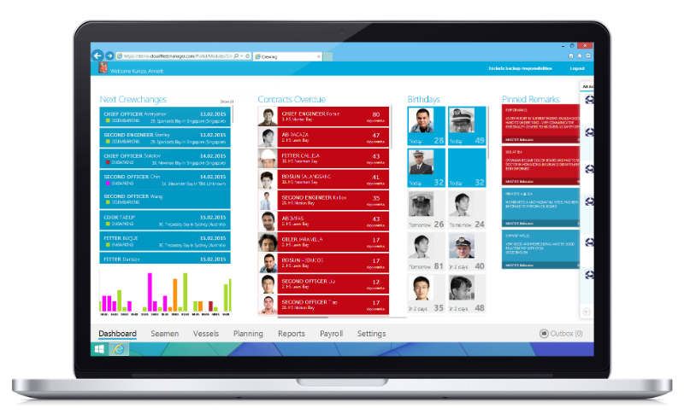
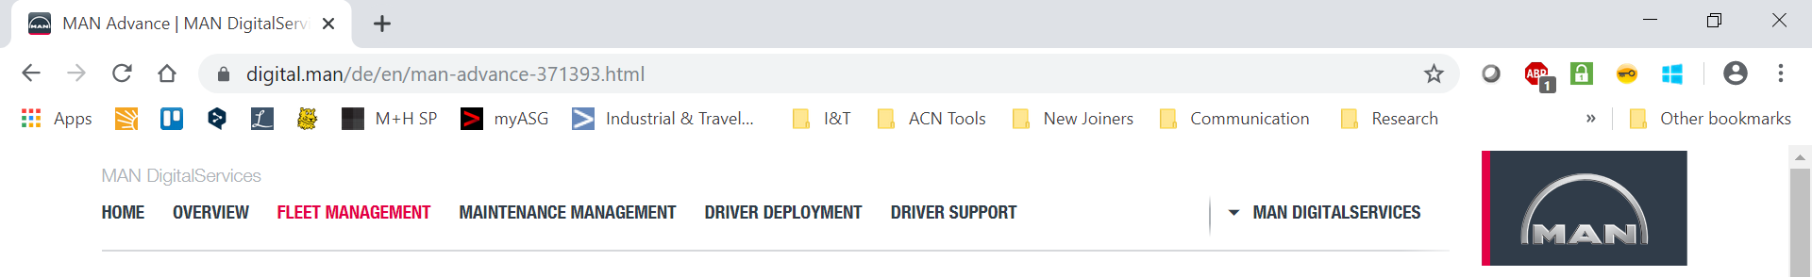
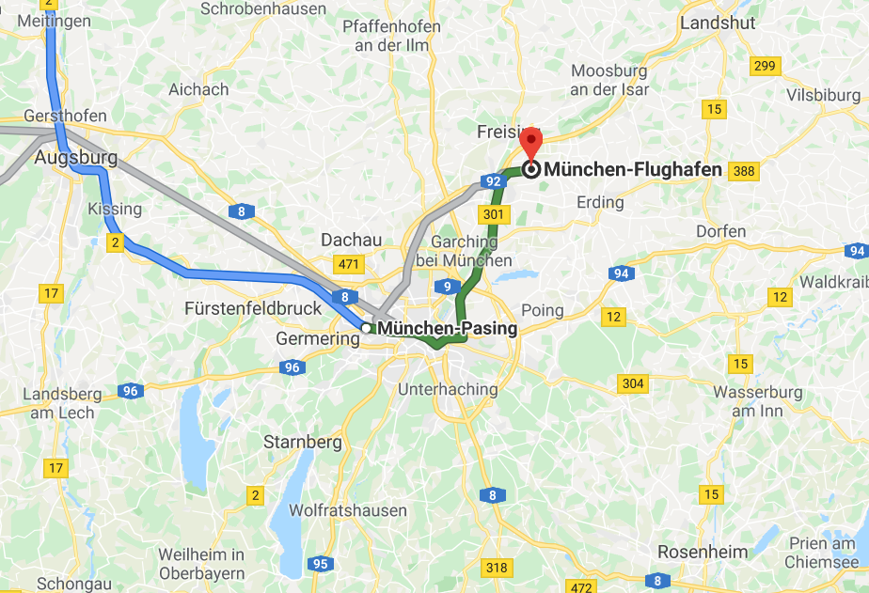

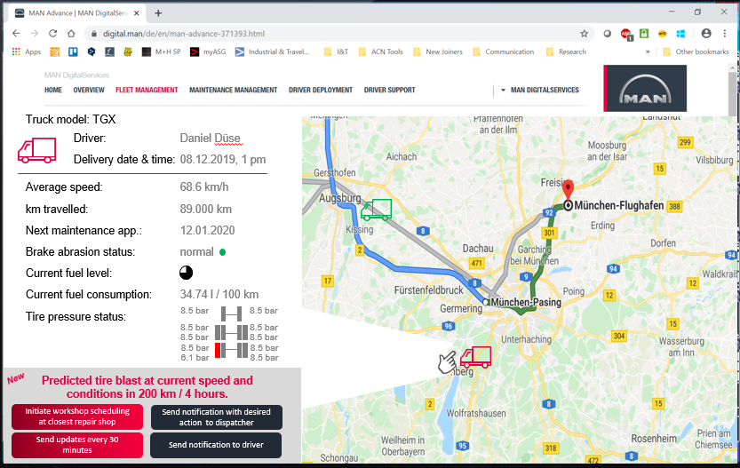

MAN Predictive Tire Breakdown – Look & Feel
Truck model: TGX
Driver:
Daniel Düse
Delivery date & time:
08.12.2019, 1 pm
Average speed:
68.6 km/h
km travelled:
89.000 km
Next maintenance app.:
12.01.2020
Brake abrasion status:
normal
Current fuel level:
Current fuel consumption:
34.74 l / 100 km
Tire pressure status:
8 bar
8 bar
8 bar
8 bar
8 bar
8 bar
8 bar
6.1 bar
8 bar
8 bar
New
Tire pressure alert:
Break down in approx. 500 km.
Send closest workshop repair schedule task to dispatcher
Send notification to dispatcher
Send updates every 30 minutes
Send notification to driver

Slide 9
MAN Predictive Tire Breakdown – Idea Details
Value proposition
Prevention of truck failure and extra maintenance costs caused by tire blasts and tire-related issues.
Reduction of potential risks by alerting the reponsible decision-maker with next best actions in advance.
Ultimately, improvemnt of goods delivery performance is reached as well as keeping trucks on the road.
Customer segments
Customer relationships
Channels
Key activities
Value creatinon for multi-sided MAN customers, esp.:
Fleet Managers & Dispatchers
Drivers
Repairshop workers
Most important customer group:
Fleet Managers & Dispatchers
(decision-maker on next actions followed prediction results)
Customers desire transparency of their fleet and truck conditions to deliver goods on time.
Fleet Manager has the buying power on MAN DigitalServices purchases. He/ she expects a personal relationship with the MAN sales representatives for consolidated advice from the trusted source (personal assistance). Independency & self-service is also desired to a certain amount.
The new service offeing is to be included in the MAN DigitalService portfolio.
The RIO platform and the MAN Marketplace serve as established sales/ purchase channels. Immediate activation and easy access is given.
MAN Predictive Tire Breakdown serves as an addtional feature that can be integrated into the the MAN Advanced Fleet Management.
Constant analyses of the real-time tire sensors and data of the tire pressure status. Defined algorithm informs the fleet manager and dispatcher of anomalities in tire conditions and provides next best actions to prevent tire breakdowns.
The recommended actions can be directly initiated pe click of the fleet manager. Data inflows from followed actions (e.g. reparis) update the algorithm and improve the predicitive model to provide accurate data.
Key resources
Key Partner
Cost streams
Revenue streams
Truck model data
Tire pressure data
Air leakage rate
Tire temperature data
Mileage data/ information
Axle weight data
Optimization of data through more accurate data from inputs of drivers via Driver App and workshops via repair personnel.
Cost drivers are the initial software development, set up of the predicitve model and algorithm and the maintenance and model development/ data processing.
Additional service is paid for in a subscription fee model on a monthly basis (6, 12, 18, 24 months) per truck (technical feasible, retrofit option possible at extra fee: 250€).
Free trial is offered for 3 months.
Prices: 15 – 57€.

Slide 10
MAN Predictive Tire Breakdown – Business Case
Key components
MAN Predictive Tire Breakdown results
MAN Predictive Tire Breakdown is a platform service and subscription model – once user base is established, the full benefits and scale economies are realized
MAN Predictive Tire Breakdown service offering also includes a retrofit option, in order to offer the benefits to all customer’s trucks
MAN Predicitive Tire Breakdown will be operated on the RIO platform, i.e. cost-sharing in technical and support infrastructure
Profit (p.a.)
in tsd. €
Revenues (p.a.)
2.969,6
1.475,6
1.968,1
2.415,6
0,0
194,2
393,0
1.414,1
921,6
-604,0
-359,8
-161,0
2020
2021
2022
2023
2024
2025

Slide 11
Our Vision:
MAN Predictive Tire Breakdown
Build a modular predicitive services portfolio that improves itself on machine learning technologies, increasing fleet uptime and fleet management efficiency.

